Slide 1

Notes:
N =
Root
2

Slide 2

Boundary Traversal of Binary Tree
Notes:
Section End/Start
Use this at section’s start or end. For example: “Questions” or “Time for Practice”. To be used for Impacts (get the student’s attention).

Slide 3

Boundary Traversal of Binary Tree
Given a binary tree, print boundary nodes of the binary tree Anti-Clockwise starting from the root.
The boundary includes
left boundary (nodes on left excluding leaf nodes)
leaves (consist of only the leaf nodes)
right boundary (nodes on right excluding leaf nodes)
Notes:
Blank slide (Text Only)
Use this slide as an extension of other slides. Therefore, if the data doesn’t fit in any of the slides then put the extra data here.

Slide 4
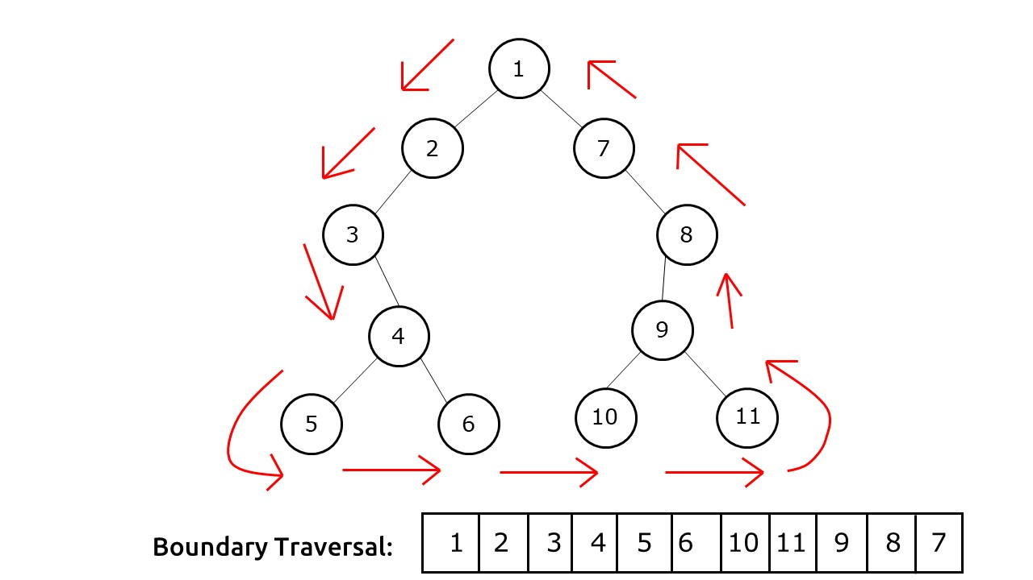
Boundary Traversal of Binary Tree
Notes:
Blank slide (Text Only)
Use this slide as an extension of other slides. Therefore, if the data doesn’t fit in any of the slides then put the extra data here.

Slide 5

import java.util.*;
import java.util.Map.Entry;
class Node {
int data;
Node left, right;
public Node(int data){
this.data = data;
left = right = null;
}
}
class Main {
static Node root;
private List<Integer> path1 = new ArrayList<>();
private List<Integer> path2 = new ArrayList<>();
static Node build(String s[]){
if(s[0]=="N"||s.length==0)
return null;
Node root=new Node(Integer.parseInt(s[0]));
Queue<Node> q=new LinkedList<Node>();
q.add(root);
1
2
3
4
5
6
7
8
9
10
11
12
13
14
15
16
17
18
19
20
21
22

Slide 6
int i=1;
while(!q.isEmpty() && i<s.length){
Node curr=q.poll();
String cval=s[i];
if(!cval.equals("N")){
int h=Integer.parseInt(cval);
curr.left=new Node(h);
q.add(curr.left);
}
i++;
if(i >= s.length)
break;
cval = s[i];
if(!cval.equals("N")){
int h=Integer.parseInt(cval);
curr.right=new Node(h);
q.add(curr.right);
}
i++;
}
return root;
}
23
24
25
26
27
28
29
30
31
32
33
34
35
36
37
38
39
40
41
42
43
44

Slide 7
//print the leaves void printLeaves(Node node){
if (node == null)
return;
printLeaves(node.left);
if (node.left == null && node.right == null)
System.out.print(node.data + " ");
printLeaves(node.right);
}
//left boundary
void printBoundaryLeft(Node node){
if (node == null)
return;
if (node.left != null) {
System.out.print(node.data + " ");
printBoundaryLeft(node.left);
}
else if (node.right != null) {
System.out.print(node.data + " ");
printBoundaryLeft(node.right);
}
}
45
46
47
48
49
50
51
52
53
54
55
56
57
58
59
60
61
62
63
64
65
66

Slide 8
//right boundary void printBoundaryRight(Node node){
if (node == null)
return;
if (node.right != null) {
printBoundaryRight(node.right);
System.out.print(node.data + " ");
}
else if (node.left != null) {
printBoundaryRight(node.left);
System.out.print(node.data + " ");
}
}
void printBoundary(Node node){
if (node == null)
return;
System.out.print(node.data + " ");
printBoundaryLeft(node.left);
printLeaves(node.left);
printLeaves(node.right);
printBoundaryRight(node.right);
}
67
68
69
70
71
72
73
74
75
76
77
78
79
80
81
82
83
84
85
86
87
88

Slide 9
//main method public static void main(String[] args){
Scanner sc=new Scanner(System.in);
int i;
Main ob = new Main();
String s[]=sc.nextLine().split(" ");
root = build(s);
ob.printBoundary(root);
}
}
89
90
91
92
93
94
95
96
97
98
99
100
101
102
103
104
105
106
107
108
109
110

Slide 10

THANK YOU
Notes:
Thank you slide

